Slide 1
افعال كرتون
Rahma nassar omar

Slide 2
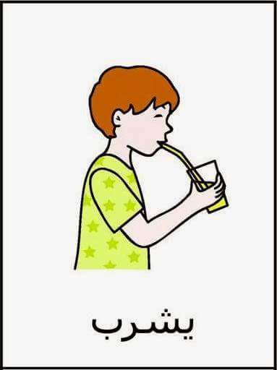
Slp:rahma

Slide 3
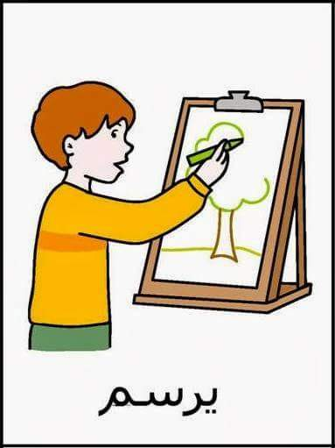
Slp:rahma

Slide 4
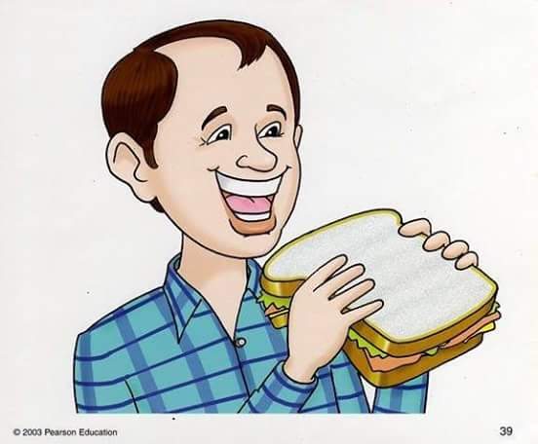
Slp:rahma

Slide 5
Slp:rahma

Slide 6
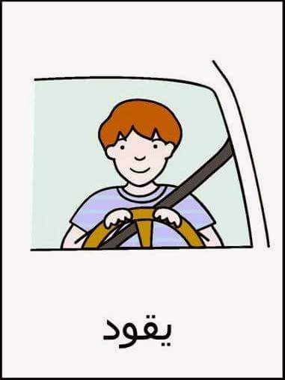
Slp:rahma

Slide 7
Slp:rahma

Slide 8
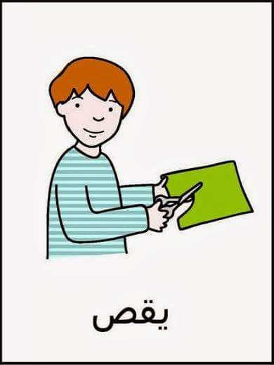
Slp:rahma

Slide 9
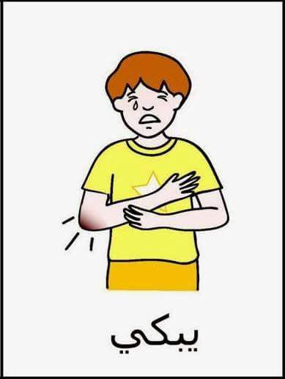
Slp:rahma

Slide 10
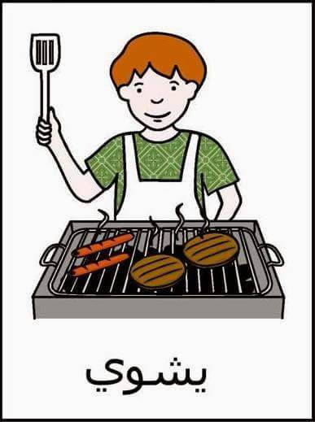
Slp:rahma

Slide 11
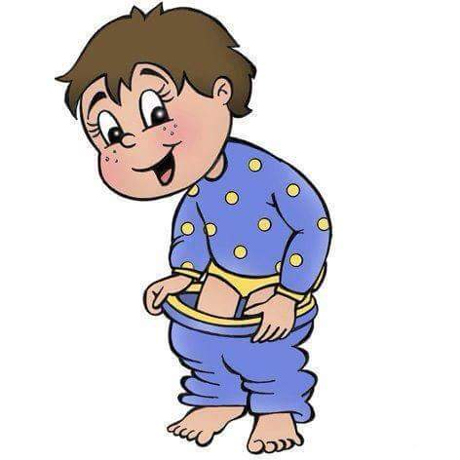
Slp:rahma

Slide 12
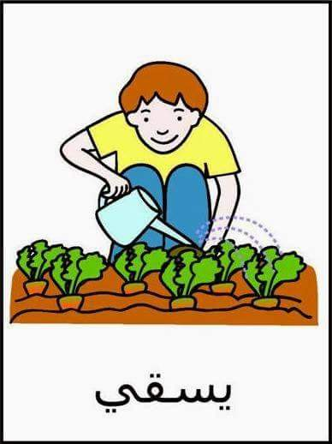
Slp:rahma

Slide 13
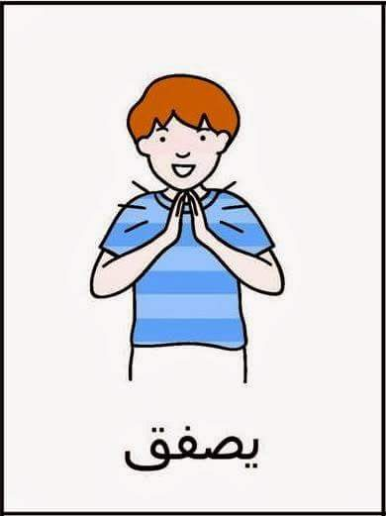
Slp:rahma

Slide 14
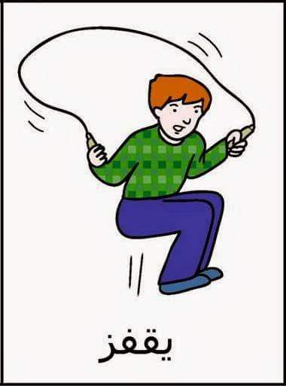
Slp:rahma

Slide 15
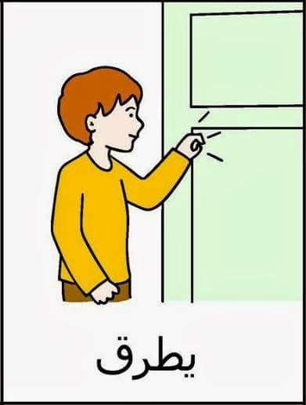
Slp:rahma

Slide 16
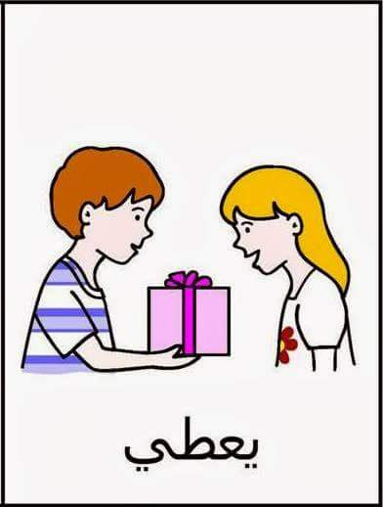
Slp:rahma

Slide 17
Slp:rahma

Slide 18
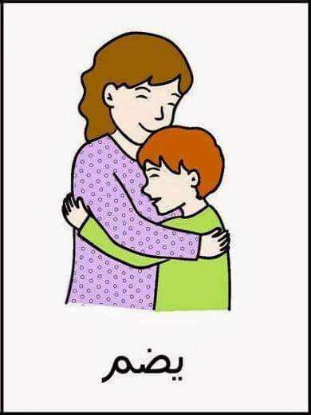
Slp:rahma

Slide 19
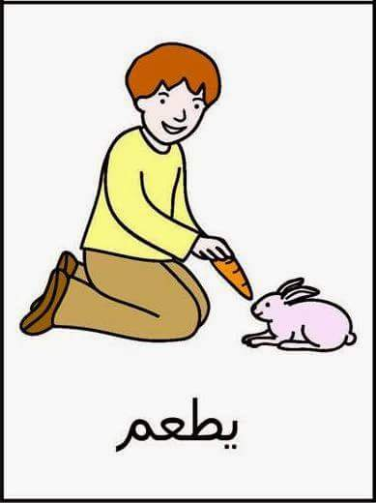
Slp:rahma

Slide 20
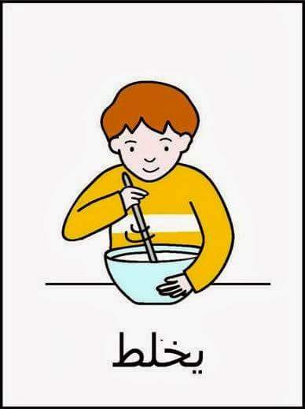
Slp:rahma

Slide 21
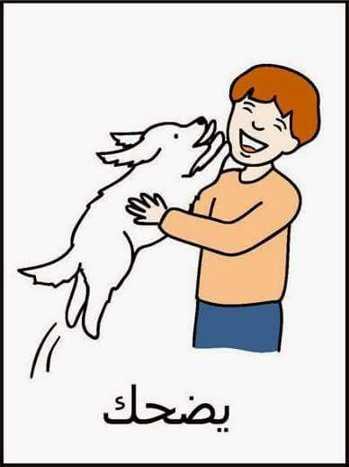
Slp:rahma

Slide 22
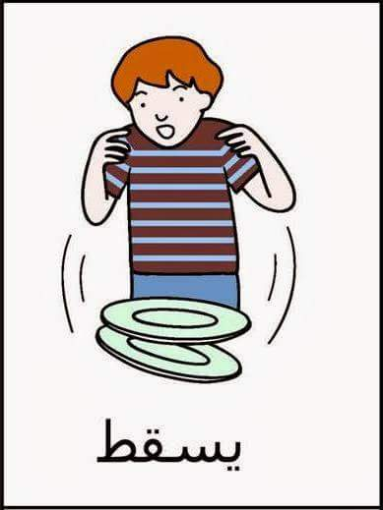
Slp:rahma

Slide 23
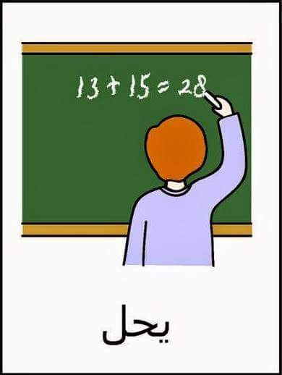
Slp:rahma

Slide 24
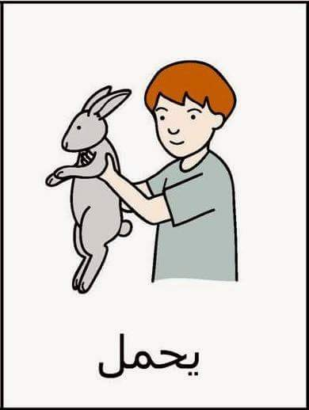
Slp:rahma

Slide 25
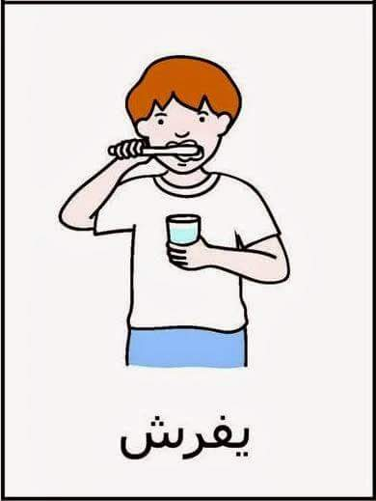
Slp:rahma

Slide 26
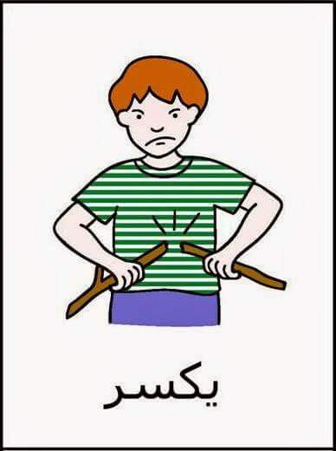
Slp:rahma

Slide 27
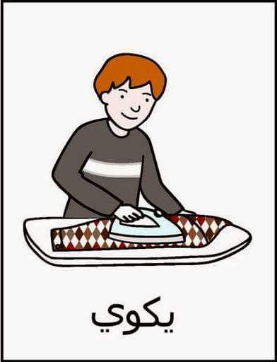
Slp:rahma

Slide 28
Slp:rahma

Slide 29
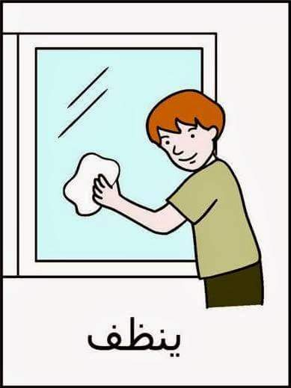
Slp:rahma

Slide 30
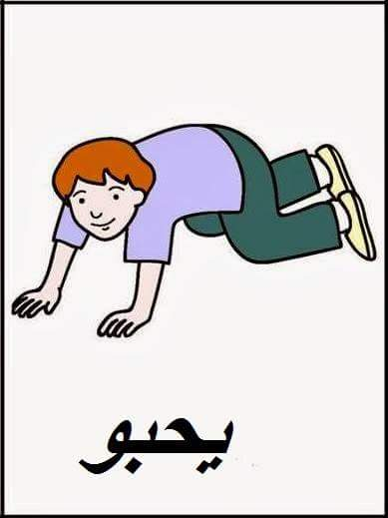
Slp:rahma

Slide 31
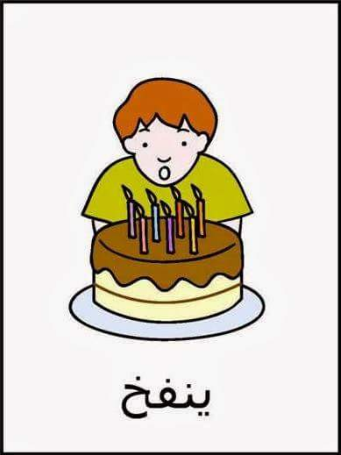
Slp:rahma

Slide 32
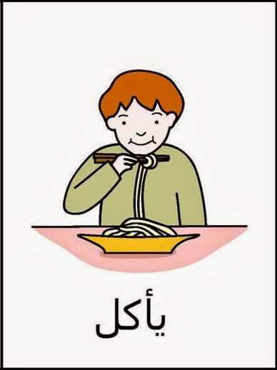
Slp:rahma

Slide 33
Slp:rahma

Slide 34
Slp:rahma

Slide 35
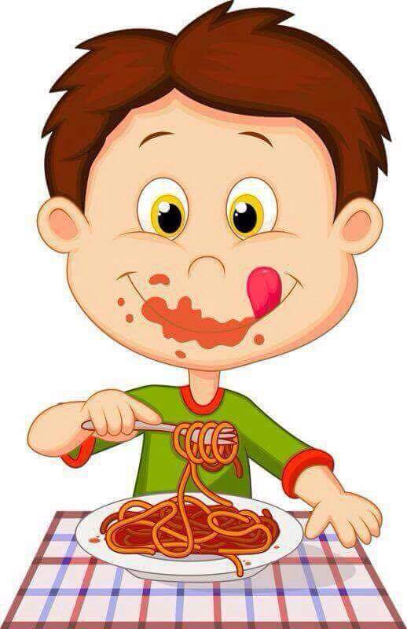
Slp:rahma

Slide 36
Slp:rahma

Slide 37
Slp:rahma

Slide 38
Slp:rahma

Slide 39
Slp:rahma

Slide 40
Slp:rahma

Slide 41
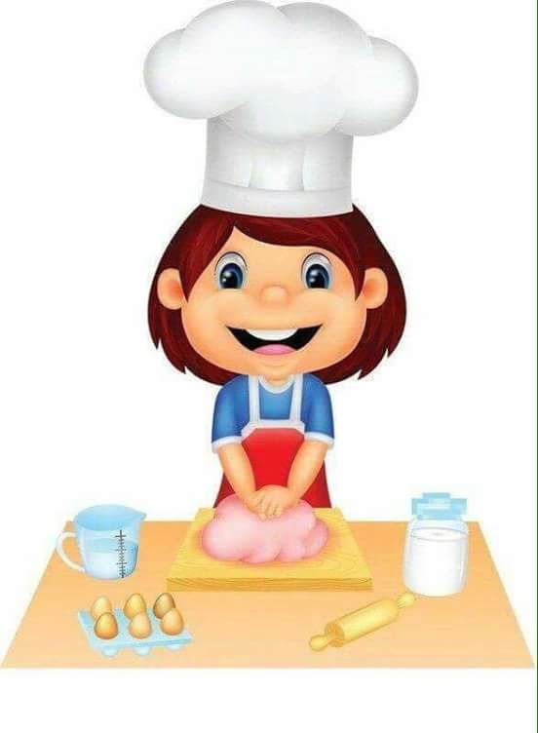
Slp:rahma

Slide 42
Slp:rahma

Slide 43
Slp:rahma

Slide 44
Slp:rahma

Slide 45
Slp:rahma

Slide 46
Slp:rahma

Slide 47
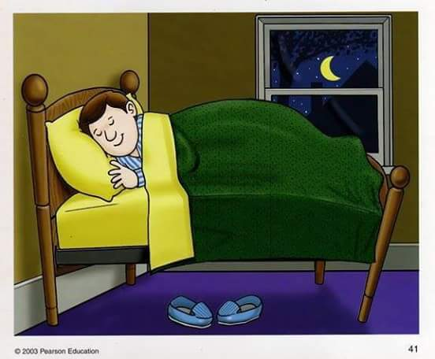
Slp:rahma

Slide 48
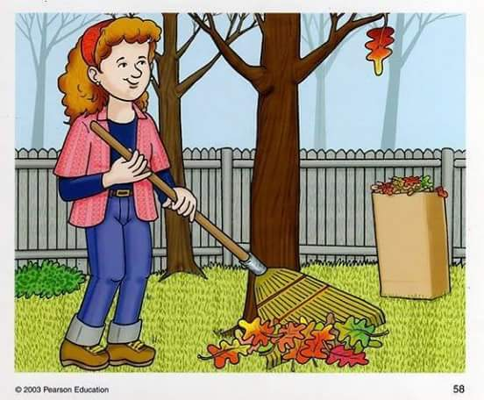
Slp:rahma

